Slide 1
Cocoa Camp
Dream Team Developers: Marla Scacchitti, Shea Fisher, Dawa Sherpa
Notes:
Dawa
Hello and Welcome to Cocoa Camp. I would like to start off by introducing our team developers of Dream Team. We have Shea Fisher, Marla Scacchitti, and myself Dawa Sherpa. We are student group looking to make innovative additions to Hershey Park and influence sustainability and family fun.

Slide 2
Cocoa Camp
Purpose
Client
Target Audience
Project Description
Backstory Summary
Notes:
Dawa
Purpose: To provide a family friendly activities beyond the typical ride and slide experience.
Client: Hershey Entertainment and Resorts
Target Audience: Families and teens between the ages of 12-22; The attractions are targeted towards different age groups
Project Description: Outdoor fun with multiple attractions including ropes courses, zip lines, bungee trampolines, and more. This new land also includes an eatery, rest stops, and shopping opportunities.
Back story: Summary: A group of friends discover a hidden land of Hershey candy people behind a mountain pass near their campsite. They develop the land into the Cocoa Camp theme park.

Slide 3
Cocoa Camp: Style Guide
Theme: Outdoor Candy Forest
Fonts: Hershey Company Fonts and Western Swagger DEMO
Colors: Hershey Product Colors and Forest Color Scheme
Architecture: Camp Store, Tents, Hershey Eatery, Benches, Restrooms
Signage: Characters Holding the Main Attraction(s) and wooden signs
Notes:
Marla

Slide 4
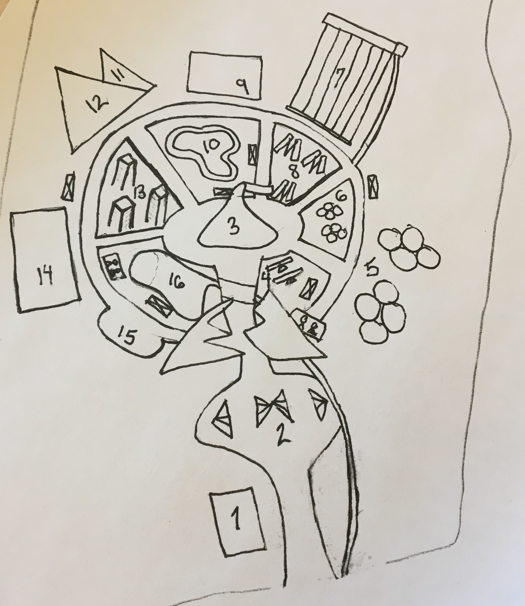
Cocoa Camp: Overview Map
Camp Store
Camp site
Hershey Eatery
Teeter Totters
Bungee Trampolines
Little Bungee Trampolines
Zip lines
King Swings
Low Ropes Course
Family Plank Walk Race
Rock Climbing Wall
Repelling Wall
Rope Climbing Towers
High Ropes Course
Character Spot
Lake Area
Notes:
Shea
Talk about theme and layout of overall area
Walk through UX experience from the entrance and through the area\
Brief introduction to each section/attraction
Mention landmarks (Hershey eatery)
Mention terms: Minimal barriers, peak end rule, points of prospect, way finding, progressive lures

Slide 5
Cocoa Camp: Base Camp
[image]
Location
Wrist bands
Gear
Notes:
Dawa
Talk about what is there?
how the users attain appropriate gear/what type of gear is needed?
explain how they make reservations for activities
explain bands and how they work

Slide 6
Cocoa Camp: General Store
Merchandise
Drinks
Snacks
Restrooms
Notes:
Marla
Merchandise: hats, t-shirts, plush character toys, backpacks, coolers/lunch bags
Drinks: water, soft drinks, smoothies
Snacks: pretzels, cheese crackers, fruit snacks, Hershey cookies
Restrooms

Slide 7
Cocoa Camp: Transition Mountain
Notes:
Shea
Transition into the candy campsite
Incorporate backstory
Talk about the experience: visually, sense of smell, and then include the reveal

Slide 8
Cocoa Camp: Landmark
[image of Hershey Kiss]
Locations
Landmark
Notes:
Marla
Eatery
Offers wide variety of snacks such as homemade Hershey Granola, Hershey S'mores, and [blank]. This eatery also offers soup, sandwiches, pizza, and mountain pies.
Inside the eatery there are also seating areas, restrooms, and lockers.

Slide 9
Cocoa Camp: Main Attractions
High ropes course
Low ropes course
Bungee trampolines
Zip lines
Rock climbing wall
Repelling wall
Notes:
Shea
Talk about reservations

Slide 10
Cocoa Camp: Main Attractions
[images]
Notes:
Explain

Slide 11
Cocoa Camp: Smaller Attractions
Family teeter totter
Plank walk race
Cargo net towers
King swing
Lake area
Notes:
Shea

Slide 12
Cocoa Camp
Cocoa Camp will encourage family fun, promote environmental sustainability, and give Hershey Park an aggressive competitive advantage. This addition will offer guests an experience beyond the typical ride and slide amusement park.
Sweet Opportunities await in Cocoa Camp
Notes:
Marla

